Slide 1
Inferential Statistics

Slide 2
Overview
L.C. O.L.
Sampling variability
Confidence intervals for population proportion.
Hypothesis testing using confidence intervals
L.C. H.L.
Normal distribution
Sampling variability
Distribution of sample means
Confidence interval for population mean
Distribution of sample proportions
Confidence interval for population proportion
The margin of error
Hypothesis testing using p-values

Slide 3
Statistical Inference
Ask a question
Census
Gather data
Gather data
Gather data
Sample
Sample
Analyse data
Can we reliably use the results from a single sample to make conclusions about a population?
Draw conclusions

Slide 4
Inferences about proportions

Slide 5
Sampling variability
What proportion of students keep their mobile phone under their pillow at night?

Slide 6
Sampling variability
Make your own statement “The proportion of all students who keep their mobile phone under their pillow at night is _____”
Sample | Statement
1
2
3
4
5
6
7

Slide 7
Sampling variability
Different samples will yield different results (due to random nature of sampling)
How then can we use a single sample to draw conclusions about a population?

Slide 8
Sampling variability

Slide 9
Sampling variability
How can we capture this uncertainty in our statement?
“The proportion of all students who keep their mobile phone under their pillow at night is _____”
The proportion of students who keep their mobile phone under their pillow at night is between 0.1 and 0.45?

Slide 10
A confidence interval
How do we decide on this range if we have one sample only?
How confident can we be that this range captures the population proportion?

Slide 11
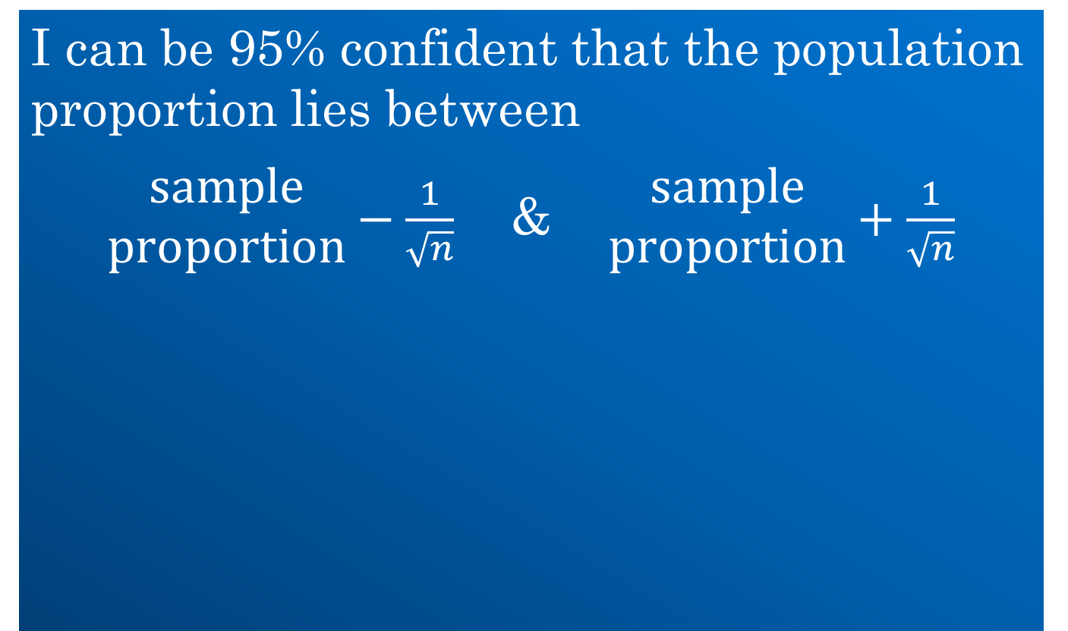
The 95% confidence interval
I can be 95% confident that the population proportion lies between
$\begin{matrix}\text{s}\text{ample} \\ \text{proportion}\end{matrix}−\frac{1}{\sqrt{n}}$ & $\begin{matrix}\text{s}\text{ample} \\ \text{proportion}\end{matrix}+\frac{1}{\sqrt{n}}$
Notes:
Students calculate their 95% confident interval

Slide 12
What does 95% confidence mean?

Slide 13
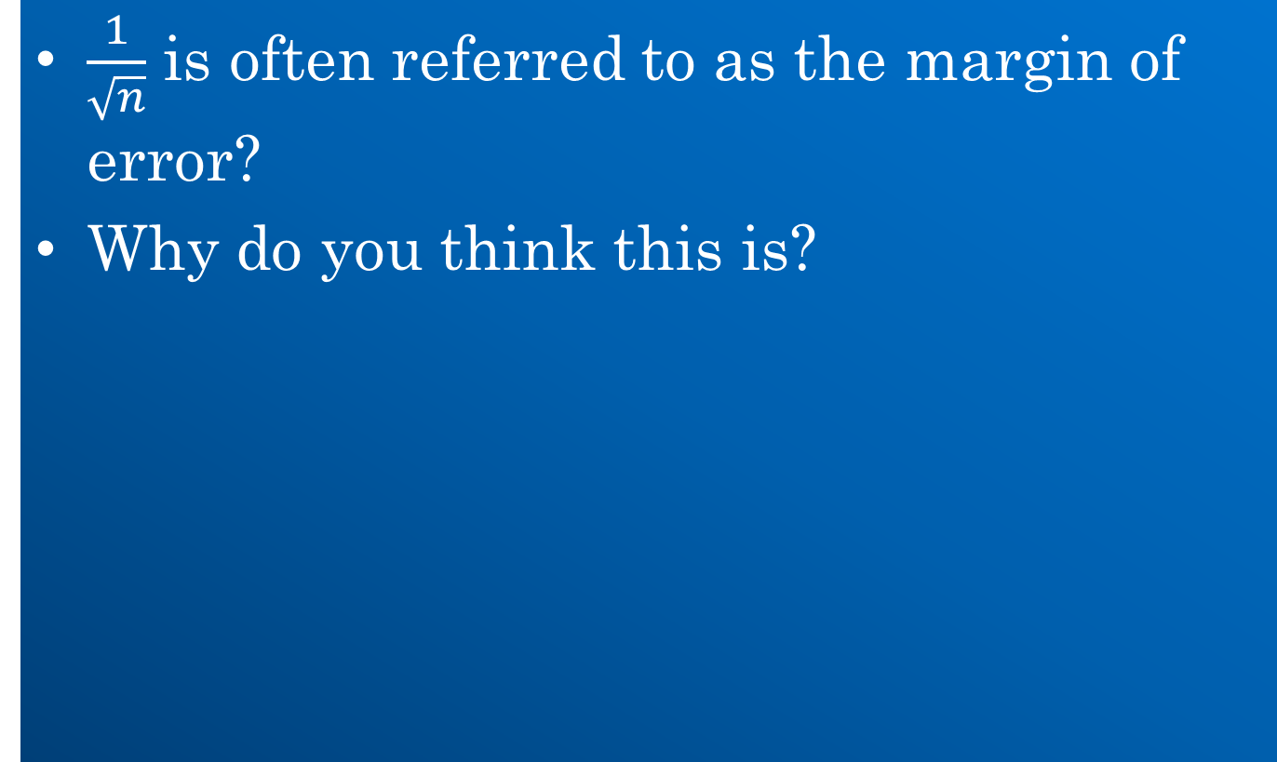
The margin of error
$\frac{1}{\sqrt{n}}$ is often referred to as the margin of error?
Why do you think this is?

Slide 14
The margin of error
How could you make your margin of error small?
Why should ε depend on n?
ε
n | ε
1 | 1
10 | 0.316
100 | 0.1
500 | 0.045
1000 | 0.032
2000 | 0.022
5000 | 0.014
n

Slide 15
The margin of error
Why might you want to make your margin of error small?

Slide 16
The power of statistics
4.6 million
1.36 billion

Slide 17
Assessment of student understanding

Slide 18
Assessment of student understanding

Slide 19
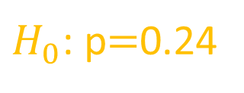
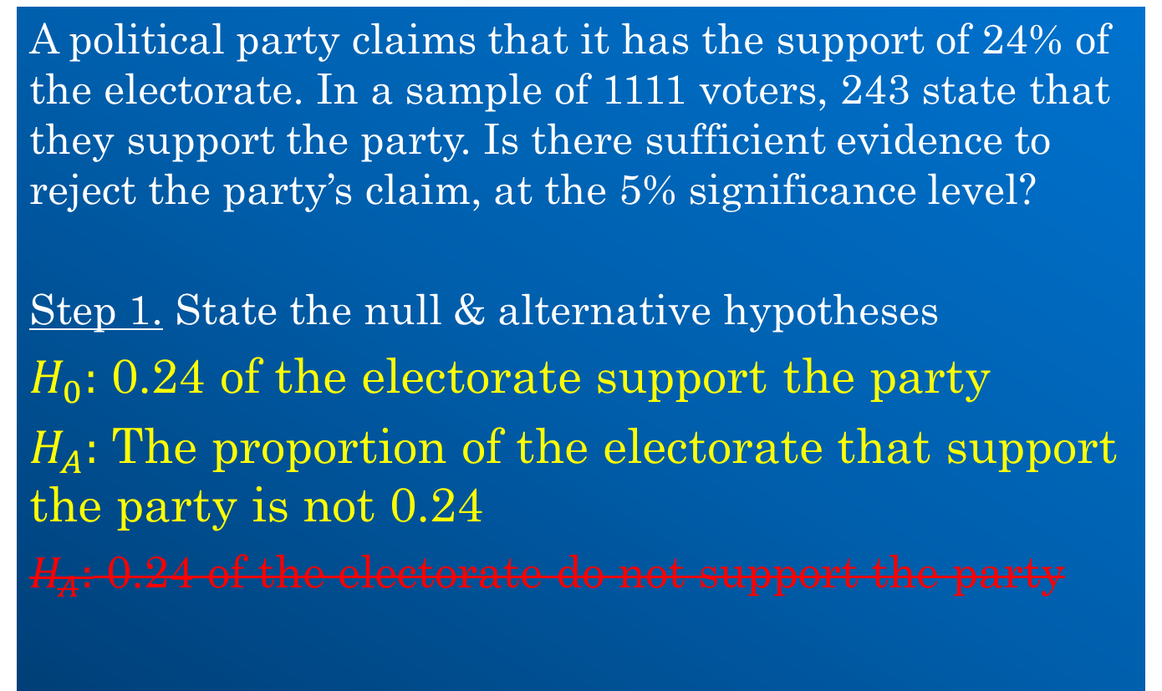

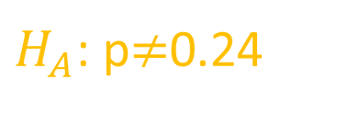
Hypothesis tests
A political party claims that it has the support of 24% of the electorate. In a sample of 1111 voters, 243 state that they support the party. Is there sufficient evidence to reject the party’s claim, at the 5% significance level?
Step 1. State the null & alternative hypotheses
$H_{0}:$ 0.24 of the electorate support the party
$H_{A}:$ The proportion of the electorate that support the party is not 0.24
$H_{A}:$ 0.24 of the electorate do not support the party
The term “null hypothesis” comes from the idea of a “null effect” or “no change” so $H_{0}$ should be stated as such i.e. as a statement of no change.
Null Hypothesis
$H_{0}$: p$=$0.24
$H_{A}$: p$≠$0.24
intermediate step to help students with language

Slide 20
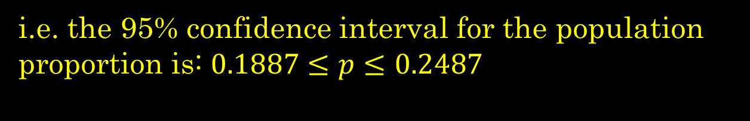
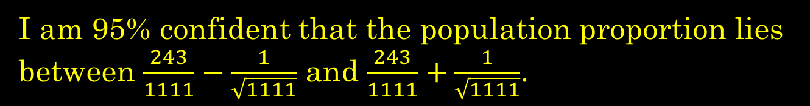
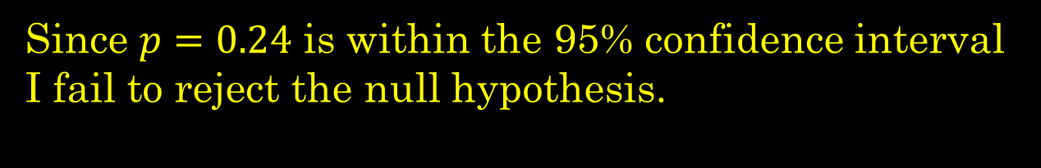
Hypothesis tests
Step 2. Build a 95% confidence interval for the population proportion.
Step 3. Make conclusion based on whether hypothesised proportion is inside or outside the confidence interval.
I am 95% confident that the population proportion lies between $\frac{243}{1111}−\frac{1}{\sqrt{1111}}$ and $\frac{243}{1111}+\frac{1}{\sqrt{1111}}$.
i.e. the 95% confidence interval for the population proportion is: $0.1887≤p≤0.2487$
Since $p=0.24$ is within the 95% confidence interval I fail to reject the null hypothesis.
There is insufficient evidence to reject the party’s claim at the 5% significance level.

Slide 21
Hypothesis tests

Slide 22
Inferential Statistics
Leaving Cert. Higher Level

Slide 23
Statistical Inference
Ask a question
Census
Gather data
Gather data
Gather data
Sample
Sample
Analyse data
Can we reliably use the results from a single sample to make conclusions about a population?
Draw conclusions

Slide 24
Prior knowledge

Slide 25

The Normal Distribution
de Moivre
Gauss
Laplace
Quételet
$$z=\frac{x−μ}{σ}$$

Slide 26
The Normal Distribution
The heights of Irish males is normally distributed with a mean of 176 cm and a standard deviation of 6.5 cm.
What proportion of Irish males have heights between 169.5 cm and 182.5 cm?
What proportion of Irish males have heights between 166.5 cm and 185.5 cm?
What proportion of Irish males have heights greater than 190 cm?
What proportion of Irish males have heights equal to 190 cm?
If I choose an Irish male at random, what is the probability he will have a height greater than 190 cm?
If I choose an Irish male at random, what is the probability he will have a height of 190 cm?

Slide 27
Sampling variability
A good understanding of sampling variability lays the foundations for
confidence intervals
hypothesis testing
Sketching the distribution of the sample statistic is a key skill students should develop

Slide 28
Inferences about means

Slide 29
Sampling variability
What is the mean schoolbag weight for Irish secondary-school students?
4.9
4.5
5.2
5.3

Slide 30
Sampling variability
Make your own statement “The mean schoolbag weight for all Irish post-primary students is _____”
Sample | Statement
1
2
3
4
5
6
7

Slide 31

Sampling variability
Sampling variability means we cannot equate the results from a single sample with those for a population.
$$μ≠\overline{x}$$

Slide 32
The distribution of sample means
In spite of this we can still use a single sample to make a valid statement about a population
To do so we need to understand all the possible means we can get when we choose a sample.

Slide 33
The distribution of sample means
Different samples give different means but the distribution of sample means is normal (for large sample sizes).

Slide 34

The distribution of sample means
The centre of the distribution ($μ_{\overline{x}}$) is identical to the population centre ($μ$).

Slide 35
The distribution of sample means
The distribution is more compact than the population.

Slide 36
The distribution of sample means
Why is the distribution of sample means more compact than the population?

Slide 37
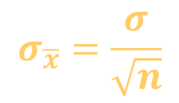
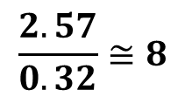
The distribution of sample means
How does the spread of the distribution of sample means compare to the population?
$$\frac{2.57}{0.32}≅8$$
$$σ_{\overline{x}}=\frac{σ}{\sqrt{n}}$$

Slide 38
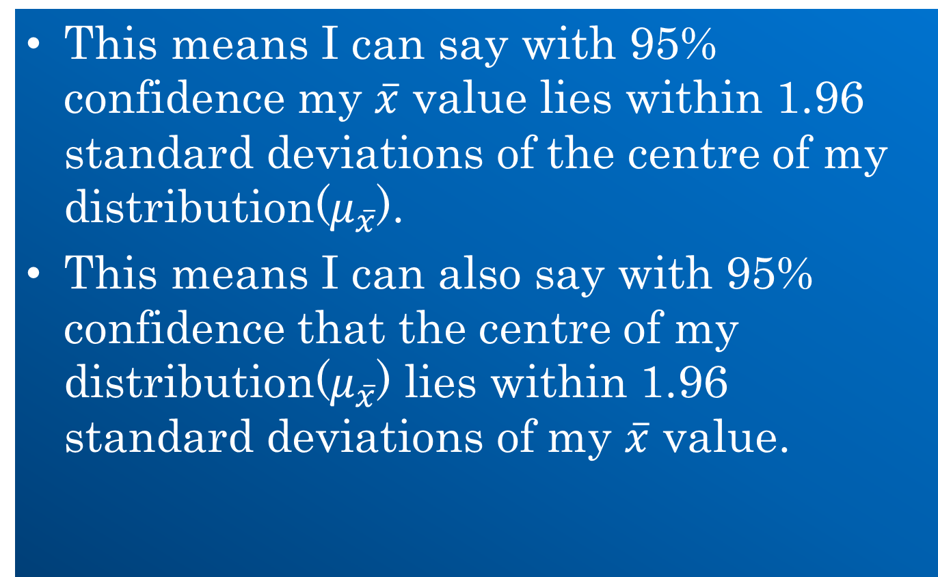
The 95% confidence interval
This means I can say with 95% confidence my $\overline{x}$ value lies within 1.96 standard deviations of the centre of my distribution($μ_{\overline{x}}$).
This means I can also say with 95% confidence that the centre of my distribution($μ_{\overline{x}}$) lies within 1.96 standard deviations of my $\overline{x}$ value.

Slide 39
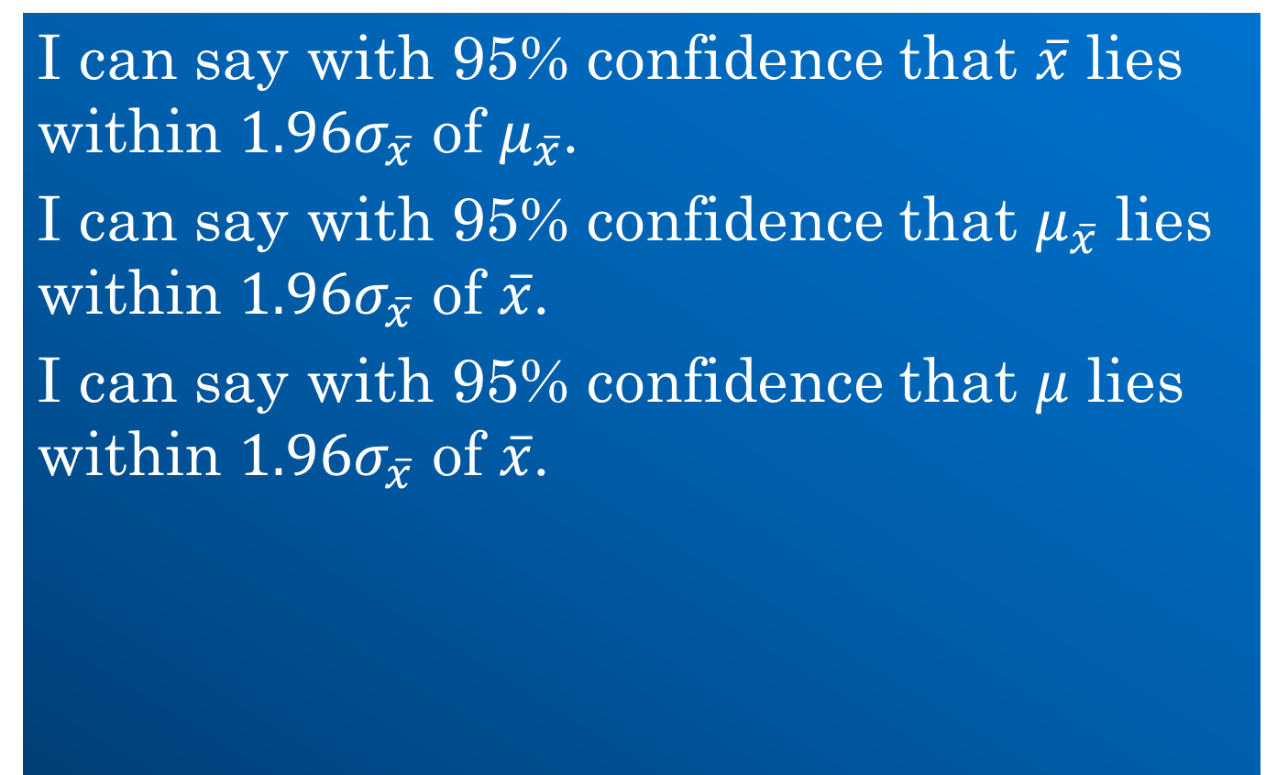
The 95% confidence interval
I can say with 95% confidence that $\overline{x}$ lies within $1.96σ_{\overline{x}}$ of $μ_{\overline{x}}$.
I can say with 95% confidence that $μ_{\overline{x}}$ lies within $1.96σ_{\overline{x}}$ of $\overline{x}$.
I can say with 95% confidence that $μ$ lies within $1.96σ_{\overline{x}}$ of $\overline{x}$.

Slide 40


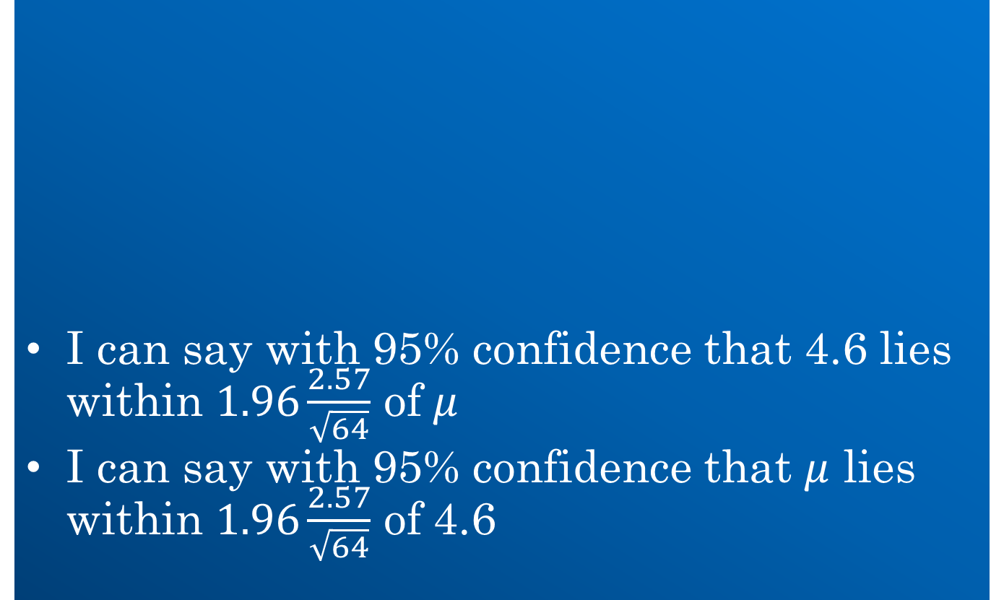
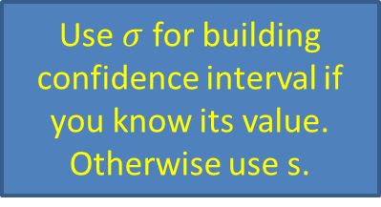

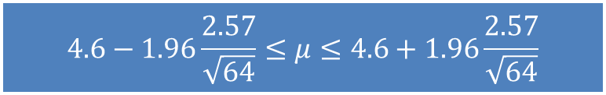
Constructing a 95% confidence interval
I can say with 95% confidence that 4.6 lies within $1.96\frac{2.57}{\sqrt{64}}$ of $μ$
I can say with 95% confidence that $μ$ lies within $1.96\frac{2.57}{\sqrt{64}}$ of 4.6
$$\frac{2.57}{\sqrt{64}}$$
Use $σ$ for building confidence interval if you know its value. Otherwise use s.
$$μ$$
$$μ_{\overline{x}}$$
$$4.6−1.96\frac{2.57}{\sqrt{64}}≤μ≤4.6+1.96\frac{2.57}{\sqrt{64}}$$

Slide 41

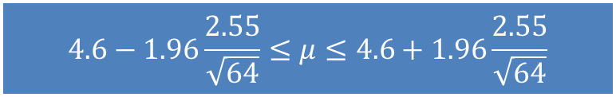

Constructing a 95% confidence interval
$$\frac{2.57}{\sqrt{64}}$$
$$\frac{2.55}{\sqrt{64}}$$
$$μ$$
$$4.6−1.96\frac{2.55}{\sqrt{64}}≤μ≤4.6+1.96\frac{2.55}{\sqrt{64}}$$

Slide 42
Assessment of student understanding

Slide 43
Assessment of student understanding

Slide 44
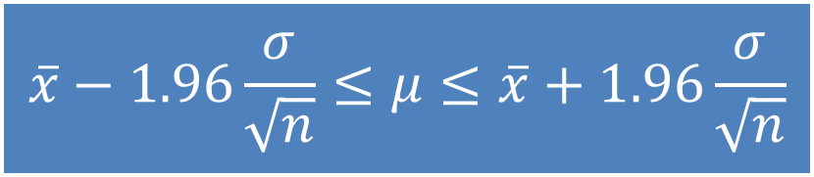
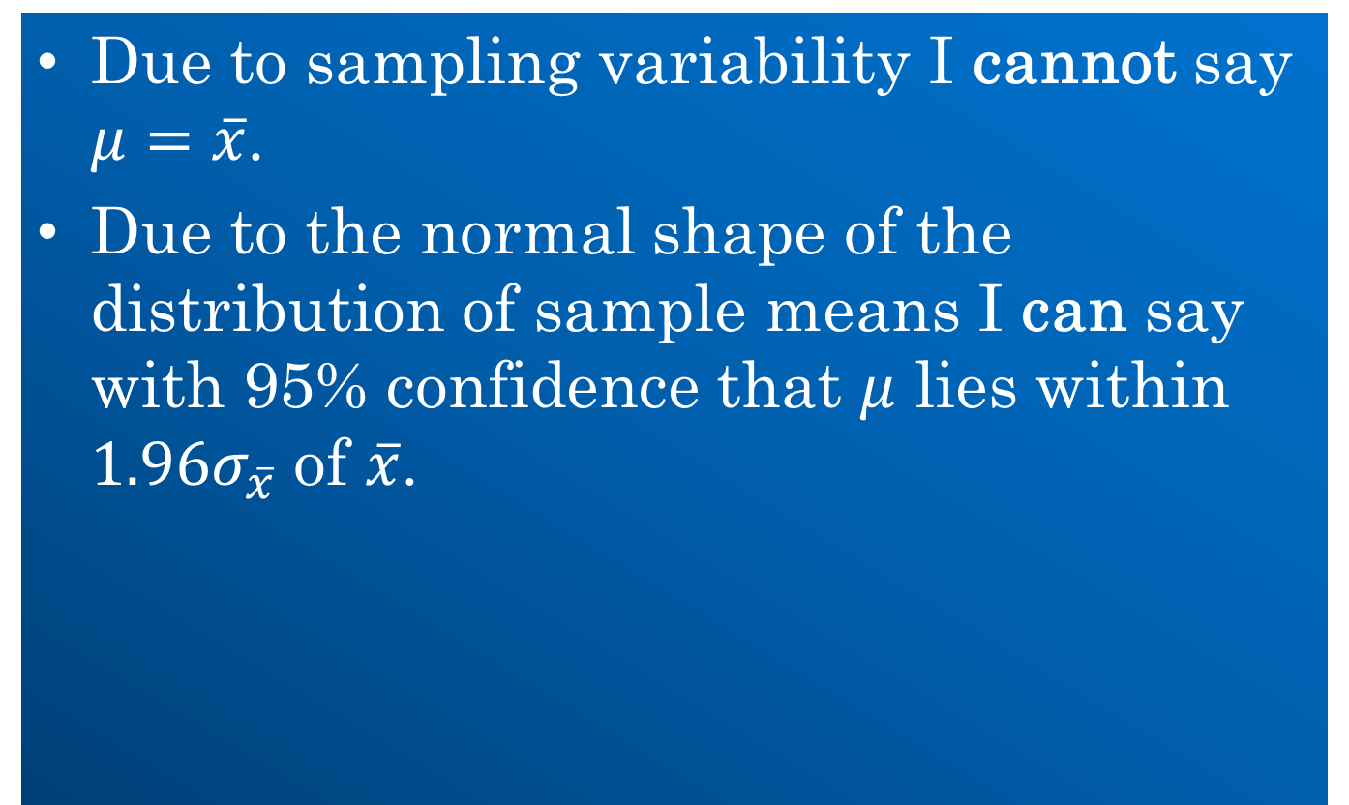
Summary
Due to sampling variability I cannot say $μ=\overline{x}$.
Due to the normal shape of the distribution of sample means I can say with 95% confidence that $μ$ lies within $1.96σ_{\overline{x}}$ of $\overline{x}$.
$$\overline{x}−1.96\frac{σ}{\sqrt{n}}≤μ≤\overline{x}+1.96\frac{σ}{\sqrt{n}}$$

Slide 45
Inferences about proportions

Slide 46
Sampling variability
What proportion of students keep their mobile phone under their pillow at night?

Slide 47
Sampling variability
Make your own statement “The proportion of all students who keep their mobile phone under their pillow at night is _____”
Sample | Statement
1
2
3
4
5
6
7

Slide 48

Sampling variability
Sampling variability means we cannot equate the results from a single sample with those for a population.
$$p≠\hat{p}$$

Slide 49
The distribution of sample proportions
In spite of this we can still use a single sample to make a valid statement about a population
To do so we need to understand all the possible proportions we can get when we choose a sample.

Slide 50
The distribution of sample proportions
Different samples give different proportions but they all follow a normal distribution.

Slide 51

The distribution of sample proportions
The centre of the distribution ($μ_{\hat{p}}$) is identical to the population proportion ($p$).

Slide 52
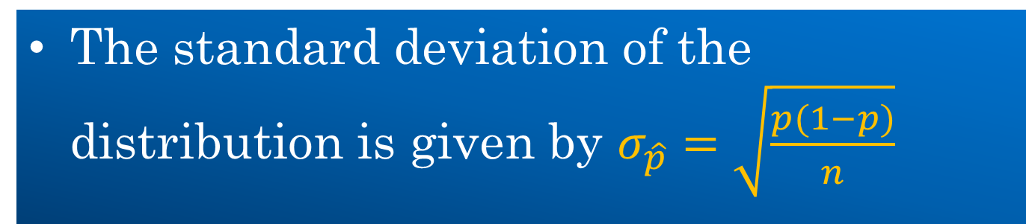
The distribution of sample proportions
The standard deviation of the distribution is given by $σ_{\hat{p}}=\sqrt{\frac{p(1−p)}{n}}$

Slide 53
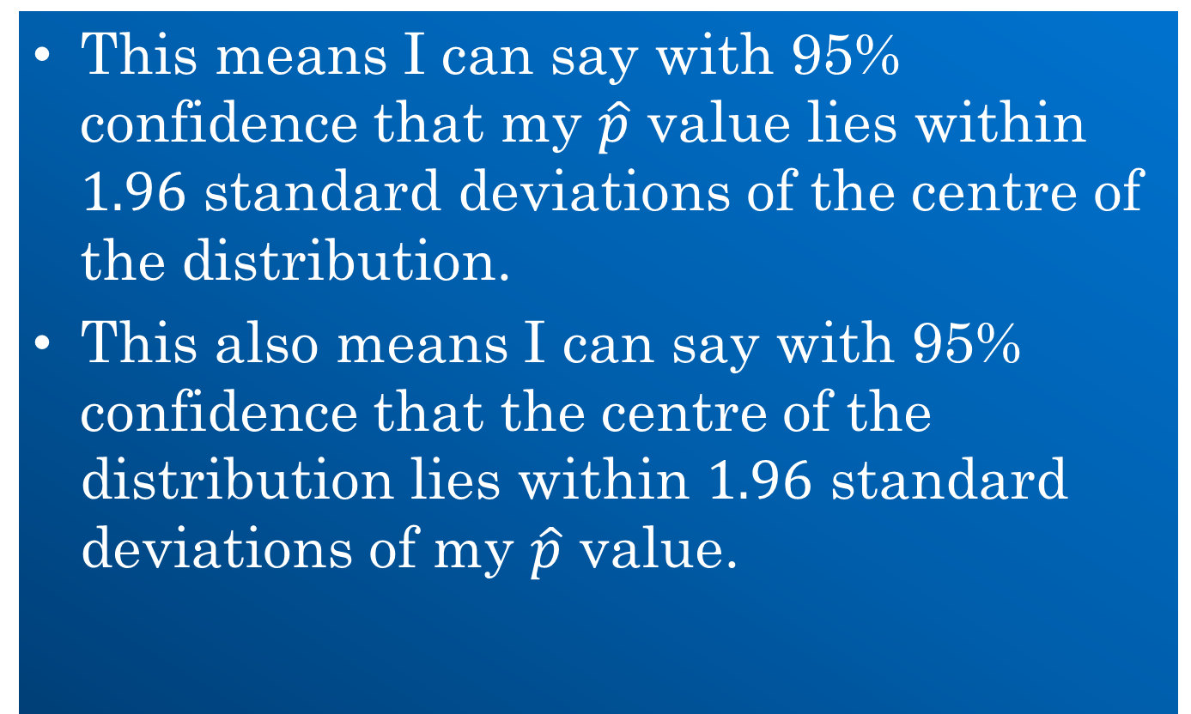
The 95% confidence interval
This means I can say with 95% confidence that my $\hat{p}$ value lies within $1.96$ standard deviations of the centre of the distribution.
This also means I can say with 95% confidence that the centre of the distribution lies within $1.96$ standard deviations of my $\hat{p}$ value.

Slide 54
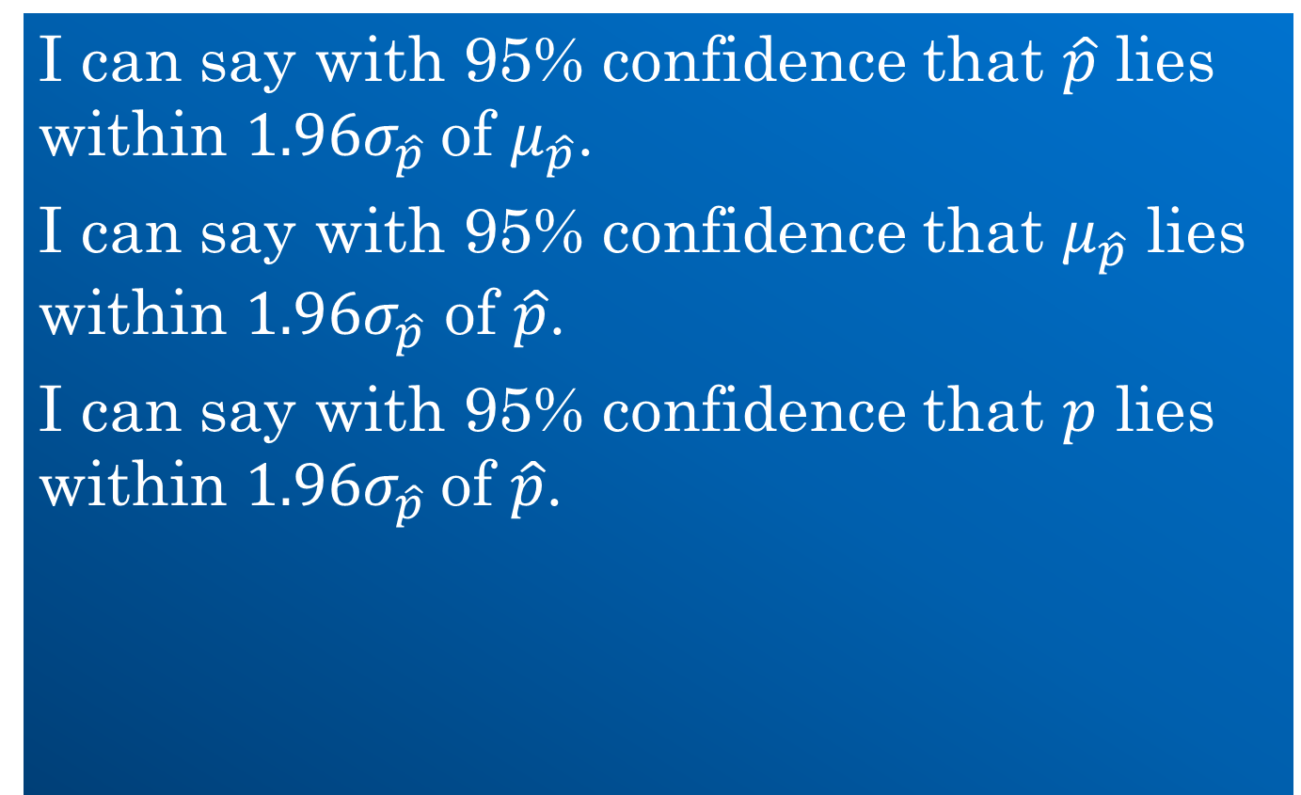
The 95% confidence interval
I can say with 95% confidence that $\hat{p}$ lies within $1.96σ_{\hat{p}}$of $μ_{\hat{p}}$.
I can say with 95% confidence that $μ_{\hat{p}}$ lies within $1.96σ_{\hat{p}}$ of $\hat{p}$.
I can say with 95% confidence that $p$ lies within $1.96σ_{\hat{p}}$of $\hat{p}$.

Slide 55


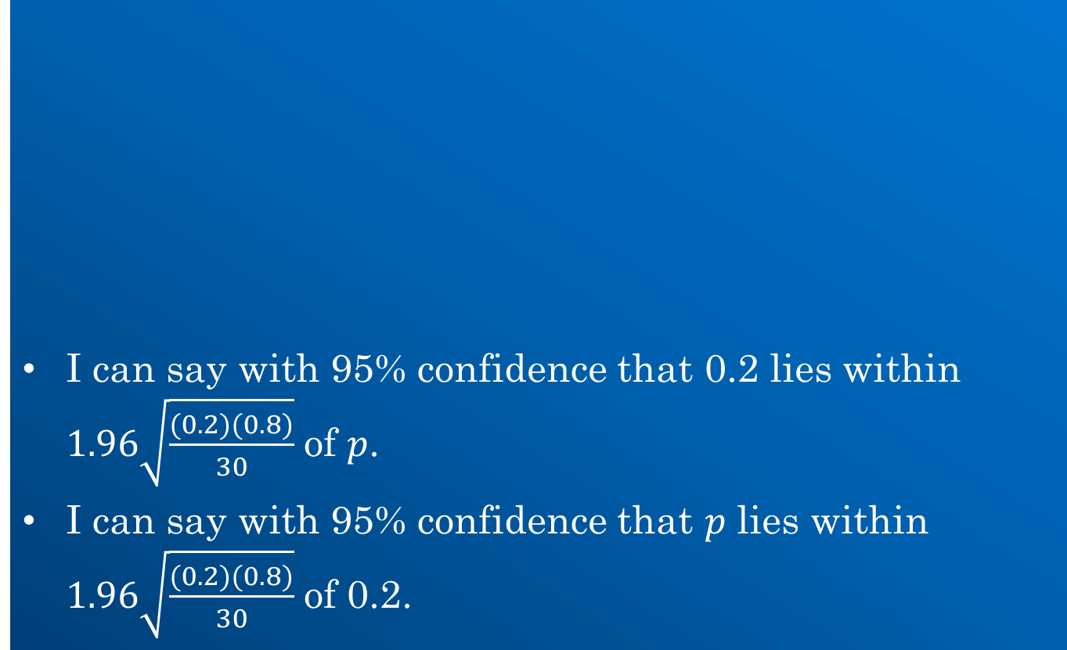

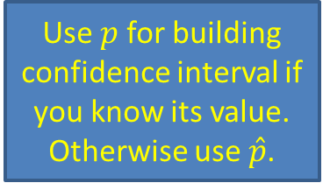
Constructing a 95% confidence interval
I can say with 95% confidence that 0.2 lies within $1.96\sqrt{\frac{(0.2)(0.8)}{30}}$ of $p$.
I can say with 95% confidence that $p$ lies within $1.96\sqrt{\frac{(0.2)(0.8)}{30}}$ of 0.2.
$$\sqrt{\frac{(0.2)(0.8)}{30}}$$
Use $p$ for building confidence interval if you know its value. Otherwise use $\hat{p}$.
$$μ_{\hat{p}}$$
$$p$$

Slide 56
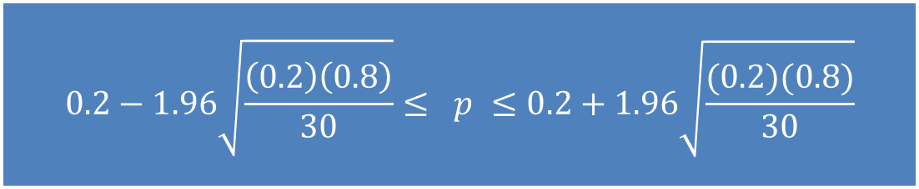
Constructing a 95% confidence interval
The 95% confidence interval for the population proportion is:
$$0.2−1.96\sqrt{\frac{\left(0.2\right)\left(0.8\right)}{30}}≤ p ≤0.2+1.96\sqrt{\frac{(0.2)(0.8)}{30}}$$

Slide 57
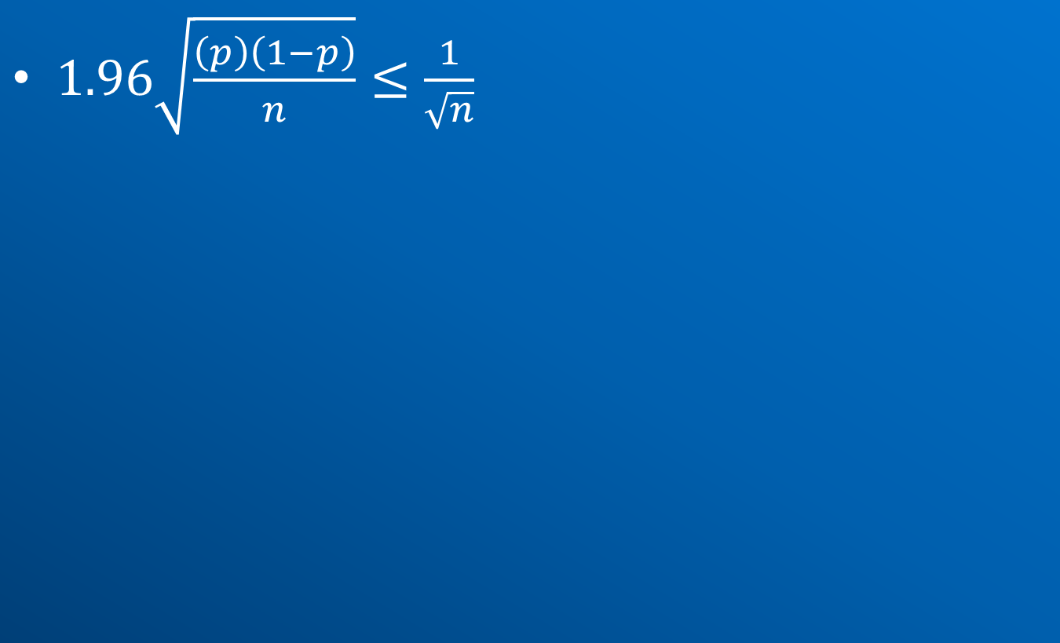
The margin of error
$1.96\sqrt{\frac{\left(p\right)\left(1−p\right)}{n}}≤\frac{1}{\sqrt{n}}$

Slide 58
Assessment of student understanding

Slide 59

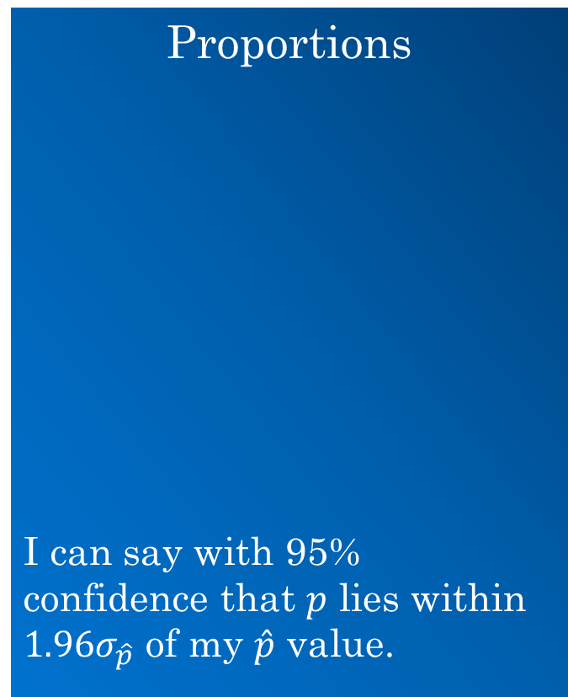

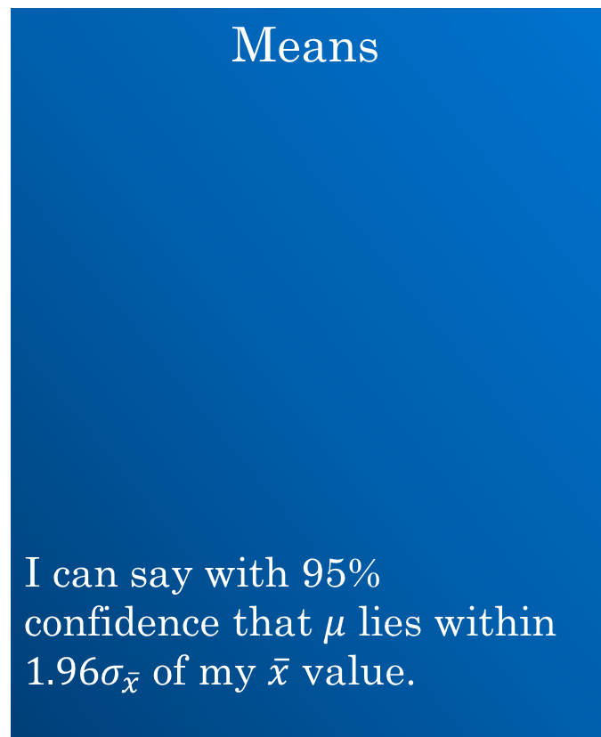


Summary
Means
I can say with 95% confidence that $μ$ lies within $1.96σ_{\overline{x}}$ of my $\overline{x}$ value.
Proportions
I can say with 95% confidence that $p$ lies within $1.96σ_{\hat{p}}$ of my $\hat{p}$ value.
$$σ_{\hat{p}}=\sqrt{\frac{\left(p\right)\left(1−p\right)}{n}}$$
Formulae
$$σ_{\overline{x}}=\frac{σ}{\sqrt{n}}$$
$$μ_{\overline{x}}=μ$$
$$μ_{\hat{p}}=p$$

Slide 60
Hypothesis testing using p-values
Hypothesis tests are based on understanding the properties of the distribution of the sample means (or sample proportions).

Slide 61
Hypothesis testing using p-values
The mean amount of time spent daily on homework & study by Leaving Cert. students in 2013-2014 was 5.4 hours with a standard deviation of 1.8 hours.
A guidance counsellor surveys 50 Leaving Cert. students in his school during 2014-2015 and finds that the mean amount of time spent on homework is 5.1 hours.
By carrying out a hypothesis test at the 5% significance level, determine if the results for 2014-2015 are consistent with those for 2013- 2014.

Slide 62
Hypothesis testing using p-values
H₀: The mean amount of time spent studying by Leaving Cert. students in 2014-2015 is 5.4 hours.
H₁: The mean amount of time spent studying by Leaving Cert. students in 2014-2015 is not 5.4 hours.

Slide 63
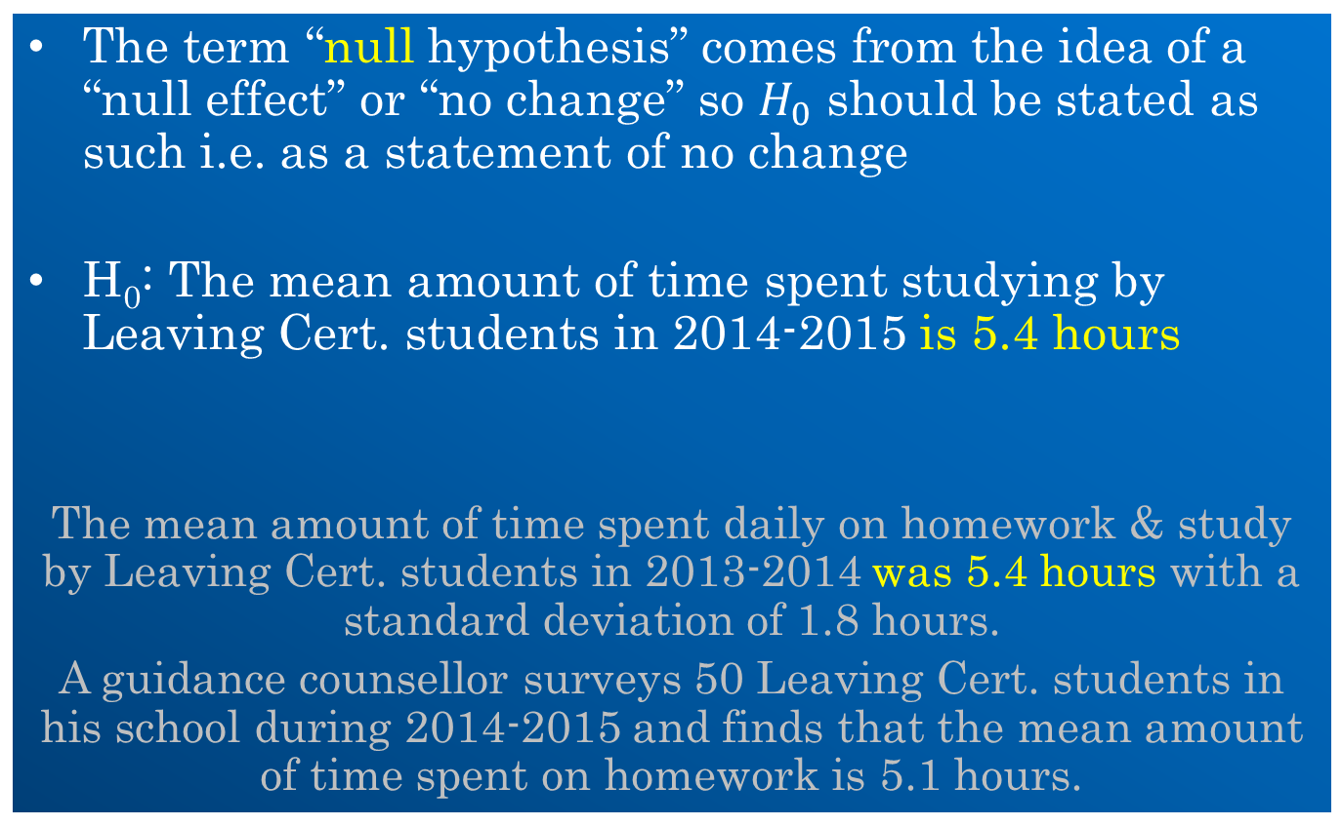
The language of a hypothesis test
The term “null hypothesis” comes from the idea of a “null effect” or “no change” so $H_{0}$ should be stated as such i.e. as a statement of no change
H₀: The mean amount of time spent studying by Leaving Cert. students in 2014-2015 is 5.4 hours
The mean amount of time spent daily on homework & study by Leaving Cert. students in 2013-2014 was 5.4 hours with a standard deviation of 1.8 hours.
A guidance counsellor surveys 50 Leaving Cert. students in his school during 2014-2015 and finds that the mean amount of time spent on homework is 5.1 hours.

Slide 64
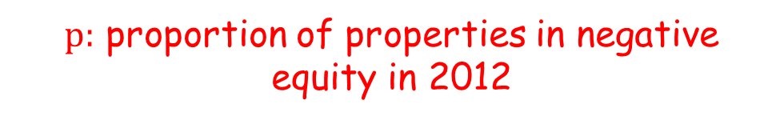
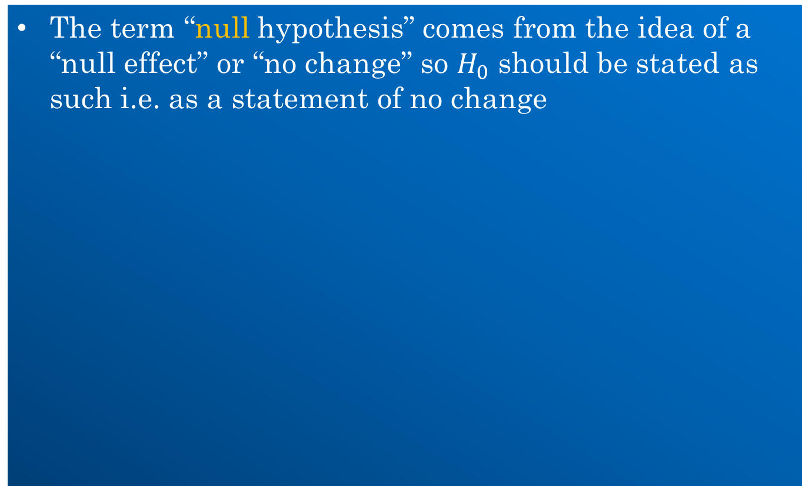
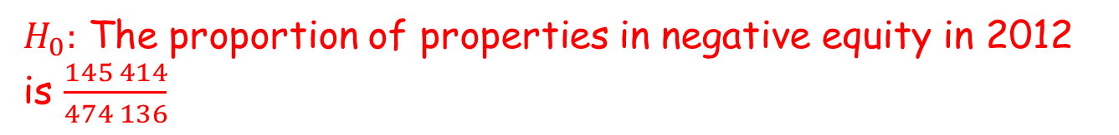
The language of a hypothesis test
The term “null hypothesis” comes from the idea of a “null effect” or “no change” so $H_{0}$ should be stated as such i.e. as a statement of no change
$H_{0}:$ The proportion of properties in negative equity in 2012 is $\frac{145 414}{474 136}$
$p:$ proportion of properties in negative equity in 2012
$H_{0}:$ $p=\frac{145 414}{474 136}$

Slide 65


Hypothesis testing using p-values
If H₀ is true we’d expect the distribution of sample means to be:
$$σ_{\overline{x}}=\frac{1.8}{\sqrt{50}}$$
$$μ_{\overline{x}}=5.4$$

Slide 66
Hypothesis testing using p-values
If H₀ is true how likely am I to get a sample mean of 5.1 due to variability?
Because of the hypothesis I need to determine how likely I am to get a sample mean of 5.1 or 5.7?
Because of the properties of the normal distribution I need to determine how likely I am to get a sample mean of less than (or equal to) 5.1 or greater than (or equal to) 5.7.

Slide 67



Hypothesis testing using p-values
Use z-scores to determine this probability
$$\left|z\right|=\frac{5.4−5.1}{\frac{1.8}{\sqrt{50}}}=1.18$$
$$P\left(\left|z\right|≥1.18\right)=2(1−0.8810)$$
$P\left(\left|z\right|≥1.18\right)=$0.238

Slide 68
Hypothesis testing using p-values
If this probability is really small, this implies that the sampling distribution is unlikely to be centred on the hypothesised value (assuming the given standard deviation)
How small is small?
5%
0.05

Slide 69
What does the p-value mean?
probability of getting results at least as unusual as the observed mean given that the null hypothesis is true.

Slide 70
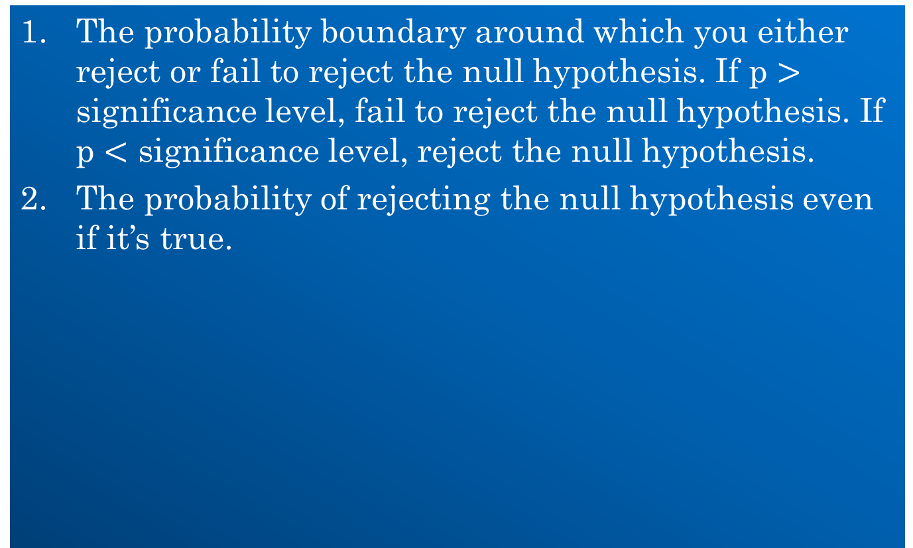
What does the level of significance mean?
The probability boundary around which you either reject or fail to reject the null hypothesis. If p $>$ significance level, fail to reject the null hypothesis. If p $<$ significance level, reject the null hypothesis.
The probability of rejecting the null hypothesis even if it’s true.

Slide 71
Assessing student understanding
The syllabus

Slide 72
Assessing student understanding
The syllabus

Slide 73
Alternative approach using p values
The syllabus

Slide 74
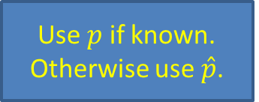
Alternative approach using p values
Use $p$ if known. Otherwise use $\hat{p}$.
The syllabus

Slide 75

Assessing student understanding
Use $σ$ if known. Otherwise use s.

Slide 76
Assessing student understanding

Slide 77
Assessing student understanding

Slide 78
Assessing student understanding

Slide 79
Summary
Hypothesis testing is built on a good understanding of
z-scores
the distribution of the sample statistic

Slide 80
Levels of significance
The level of significance is the predetermined level at which a null hypothesis is not supported. The most common level is p < .05
P =probability
< = less than (> = more than)

Slide 81
Error Type
Type I error
Reject the null hypothesis when it is really true
Type II error
Fail to reject the null hypothesis when it is really false

Slide 82
Probability
By using inferential statistics to make decisions, we can report the probability that we have made a Type I error (indicated by the p value we report)
By reporting the p value, we alert readers to the odds that we were incorrect when we decided to reject the null hypothesis

Slide 83
Particular Tests
Chi-square test of independence: two variables (nominal and nominal, nominal and ordinal, or ordinal and ordinal)
Affected by number of cells, number of cases
2-tailed distribution= null hypothesis
1-tailed distribution= directional hypothesis
Cramer’s V, Phi
example

Slide 84
Inferential Statistics (2)
Correlation—the extent to which two variables are related across a group of subjects
Pearson r
It can range from -1.00 to 1.00
-1.00 is a perfect inverse relationship—the strongest possible inverse relationship
0.00 indicates the complete absence of a relationship
1.00 is a perfect positive relationship—the strongest possible direct relationship
The closer a value is to 0.00, the weaker the relationship
The closer a value is to -1.00 or +1.00, the stronger it is
Spearman rho

Slide 85
More tests
t-test
Test the difference between two sample means for significance
pretest to posttest
Relates to research design
Perhaps used for information literacy instruction
Analysis of variance
Regression analysis (including step-wise regression)

Slide 86
More tests
While correlation and regression both indicate association between variables, correlation studies assess the strength of that association
Regression analysis, which examines the association from a different perspective, yields an equation that uses one variable to explain the variation in another variable.
Regression is used to predict the value of one variable by knowing the value of another variable

Slide 87
More tests
Multiple regression examines the relationship between a dependent variable (changes in response to the change the researcher makes to the independent variable) and two or more independent variables (manipulated variables)
Stepwise multiple regression predicts the value of a dependent variable using independent variables, and it also examines the influence, or relative importance, of each independent variable on the dependent variable

Slide 88
What is a Probability Distribution?
A probability distribution tells you what the probability of an event happening is. Probability distributions can show simple events, like tossing a coin or picking a card. They can also show much more complex events, like the probability of a certain drug successfully treating cancer.

Slide 89
There are many different types of probability distributions in statistics including:
Basic probability distributions which can be shown on a probability distribution table.
Binomial distributions, which have “Successes” and “Failures.”
Normal distributions, sometimes called a Bell Curve.
The sum of all the probabilities in a probability distribution is always 100% (or 1 as a decimal

Slide 90
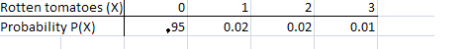
Ways of Displaying Probability Distributions
Probability distributions can be shown in tables and graphs or they can also be described by a formula. For example, the binomial formula is used to calculate binomial probabilities.
The following table shows the probability distribution of a tomato packing plant
receiving rotten tomatoes. Note that if you add all of the probabilities in the second row, they add up to 1 (.95 + .02 +.02 + 0.01 = 1).

Slide 91
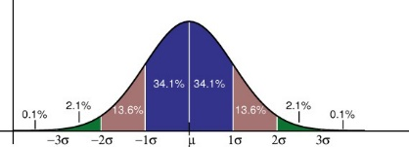
The following graph shows a standard normal distribution, which is probably the most widely used probability distribution. The standard normal distribution is also known as the “bell curve.”

Slide 92
What is a Discrete Probability Distribution?
In statistics, you’ll come across dozens of different types of probability distributions, like the binomial distribution, normal distribution and Poisson distribution. All of these distributions can be classified as either a continuous or a discrete probability distribution. A discrete probability distribution is made up of discrete variables. Specifically, if a random variable is discrete, then it will have a discrete probability distribution.

Slide 93
Discrete Probability Distribution Examples
For example, let’s say you had the choice of playing two games of chance at a fair. Game 1: Roll a die. If you roll a six, you win a prize. Game 2: Guess the weight of the man. If you guess within 10 pounds, you win a prize. One of these games is a discrete probability distribution and one is a continuous probability distribution. Which is which?

Slide 94
For game 1, you could roll a 1,2,3,4,5, or 6. All of the die rolls have an equal chance of being rolled (one out of six, or 1/6). This gives you a discrete probability distribution of:
Roll | 1 | 2 | 3 | 4 | 5 | 6
Odds | 1/6 | 1/6 | 1/6 | 1/6 | 1/6 | 1/6

Slide 95
For the guess the weight game, you could guess that the mean weighs 150 lbs. Or 210 pounds. Or 185.5 pounds. Or any fraction of a pound (172.566 pounds). Even if you stick to, say, between 150 and 200 pounds, the possibilities are endless:
160.1 lbs.
160.11 lbs.
160.111 lbs.
160.1111 lbs.
160.111111 lbs.
In reality, you probably wouldn’t guess 160.111111 lbs…that seems a little ridiculous. But it doesn’t change the fact that you could (if you wanted to), so that’s why it’s a continuous probability distribution.

Slide 96
What is Binomial Distribution?
Binomial distribution is a common probability distribution that models the probability of obtaining one of two outcomes under a given number of parameters. It summarizes the number of trials when each trial has the same chance of attaining one specific outcome. The value of a binomial is obtained by multiplying the number of independent trials by the successes.

Slide 97
Binomial Distribution
when tossing a coin, the probability of obtaining a head is 0.5. If there are 50 trials, the expected value of the number of heads is 25 (50 x 0.5). The binomial distribution is used in statistics as a building block for dichotomous variables such as the likelihood that either candidate A or B will emerge in position 1 in the midterm exams.

Slide 98
Example of Binomial Distribution
Suppose, according to the latest police reports, 80% of all petty crimes are unresolved, and in your town, at least three of such petty crimes are committed. The three crimes are all independent of each other. From the given data, what is the probability that one of the three crimes will be resolved?

Slide 99
Solution
The first step in finding the binomial probability is to verify that the situation satisfies the four rules of binomial distribution:
Number of fixed trials (n): 3 (Number of petty crimes)
Number of mutually exclusive outcomes: 2 (solved and unsolved)
The probability of success (p): 0.2 (20% of cases are solved)
Independent trials: Yes

Slide 100
Next:
We find the probability that one of the crimes will be solved in the three independent trials. It is shown as follows:
Trial 1 = Solved 1st, unsolved 2nd, and unsolved 3rd
= 0.2 x 0. 8 x 0.8
= 0.128

Slide 101
Trial 2 = Unsolved 1st, solved 2nd, and unsolved 3rd
= 0.8 x 0.2 x 0.8
= 0.128
Trial 3 = Unsolved 1st, unsolved 2nd, and solved 3rd
= 0.8 x 0.8 x 0.2
= 0.128

Slide 102
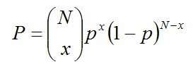
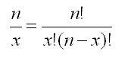
Total (for the three trials):
= 0.128 + 0.128 + 0.128
= 0.384
Alternatively, we can apply the information in the binomial probability formula, as follows:
where
In the equation, x = 1 and n = 3. The equation gives a probability of 0.384.

Slide 103
Cumulative Probability
A cumulative probability refers to the probability that the value of a random variable falls within a specified range. Frequently, cumulative probabilities refer to the probability that a random variable is less than or equal to a specified value.

Slide 104
A cumulative probability refers to the probability that the value of a random variable falls within a specified range. Frequently, cumulative probabilities refer to the probability that a random variable is less than or equal to a specified value.
P(X < 1) = P(X = 0) + P(X = 1) = 0.25 + 0.50 = 0.75

Slide 105
The table below shows both the probabilities and the cumulative probabilities associated with this experiment.
Number of heads | Probability | Cumulative Probability
0 | 0.25 | 0.25
1 | 0.50 | 0.75
2 | 0.25 | 1.00

Slide 106
Continuous Probability Distribution
robability distributions are either continuous probability distributions or discrete probability distributions. A continuous distribution has a range of values that are infinite, and therefore uncountable. For example, time is infinite: you could count from 0 seconds to a billion seconds…a trillion seconds…and so on, forever. A discrete distribution has a range of values that are countable. For example, the numbers on birthday cards have a possible range from 0 to 122 (122 is the age of Jeanne Calment the oldest person who ever lived).

Slide 107
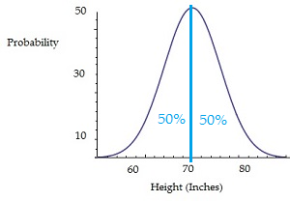
Discrete vs. Continuous Probability Distributions
A discrete probability distribution is made up of discrete variables, while a continuous probability distribution is made up of continuous variables. The two types of distributions differ in several other ways.

Slide 108
The probability that a particular random variable will equal a certain value is zero. For example, let’s say you had a continuous probability distribution for men’s heights. What is the probability that a man will have a height of exactly 70 inches? The chart shows that the average man has a height of 70 inches (50% of the area of the curve is to the left of 70, and 50% is to the right). But it’s impossible to figure out the probability of any one man measuring exactly 70 inches. Why not? Imagine measuring a man who is 70 inches tall. It’s unlikely that he’s exactly 70 inches. He’s probably 70.1 inches, or perhaps 69.97 inches. And it doesn’t stop there. He could be 70.1045 inches, or 69.9795589 inches. The fact is, it’s impossible to exactly measure any variable that’s on a continuous scale, and so it’s impossible to figure out the probability of one exact measurement occurring in a continuous probability distribution.

Slide 109
Continuous probability distributions are expressed with a formula (a Probability Density Function) describing the shape of the distribution. Discrete probability distributions are usually described with a frequency distribution table, or other type of graph or chart. For example, the following chart shows the probability of rolling a die. All of the die rolls have an equal chance of being rolled (one out of six, or 1/6). This gives you a discrete probability distribution of:
Roll | 1 | 2 | 3 | 4 | 5 | 6
Odds | 1/6 | 1/6 | 1/6 | 1/6 | 1/6 | 1/6
discrete probability distribution of:

Slide 110
Probability density function (PDF),
Probability density function (PDF), in statistics, a function whose integral is calculated to find probabilities associated with a continuous random variable (see continuity; probability theory). Its graph is a curve above the horizontal axis that defines a total area, between itself and the axis, of 1

Slide 111
Cumulative Probability
A cumulative probability refers to the probability that the value of a random variable falls within a specified range. Frequently, cumulative probabilities refer to the probability that a random variable is less than or equal to a specified value.

Slide 112
Consider a coin flip experiment. If we flip a coin two times, we might ask: What is the probability that the coin flips would result in one or fewer heads? The answer would be a cumulative probability. It would be the probability that the coin flip results in zero heads plus the probability that the coin flip results in one head. Thus, the cumulative probability would equal:
P(X < 1) = P(X = 0) + P(X = 1) = 0.25 + 0.50 = 0.75

Slide 113
The table below shows both the probabilities and the cumulative probabilities associated with this experiment.
Number of heads | Probability | Cumulative Probability
0 | 0.25 | 0.25
1 | 0.50 | 0.75
2 | 0.25 | 1.00

Slide 114
What is a Normal distribution?
A normal distribution, sometimes called the bell curve, is a distribution that occurs naturally in many situations. For example, the bell curve is seen in tests like the SAT and GRE. The bulk of students will score the average (C), while smaller numbers of students will score a B or D. An even smaller percentage of students score an F or an A. This creates a distribution that resembles a bell (hence the nickname). The bell curve is symmetrical. Half of the data will fall to the left of the mean; half will fall to the right.

Slide 115
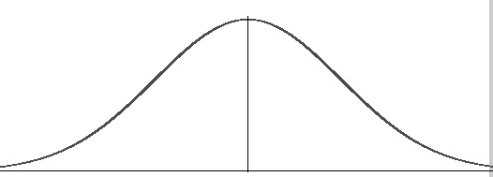

Slide 116
Many groups follow this type of pattern. That’s why it’s widely used in business, statistics and in government bodies like the FDA:
Heights of people.
Measurement errors.
Blood pressure.
Points on a test.
IQ scores.
Salaries.

Slide 117

The empirical rule tells you what percentage of your data falls within a certain number of standard deviations from the mean: • 68% of the data falls within one standard deviation of the mean. • 95% of the data falls within two standard deviations of the mean. • 99.7% of the data falls within three standard deviations of the mean.

Slide 118
What is a Sampling Distribution?
A sampling distribution is a graph of a statistic for your sample data. While, technically, you could choose any statistic to paint a picture, some common ones you’ll come across are:
Mean
Mean absolute value of the deviation from the mean
Range
Standard deviation of the sample
Unbiased estimate of variance
Variance of the sample

Slide 119
Central Limit Theorem
The Central Limit Theorem states that the sampling distribution of the sample means approaches a normal distribution as the sample size gets larger — no matter what the shape of the population distribution. This fact holds especially true for sample sizes over 30.
All this is saying is that as you take more samples, especially large ones, your graph of the sample means will look more like a normal distribution.

Slide 120
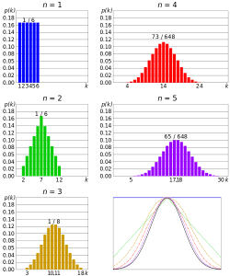

Slide 121
Central Limit Theorem Examples
A Central Limit Theorem word problem will most likely contain the phrase “assume the variable is normally distributed”, or one like it. With these central limit theorem examples, you will be given:
A population (i.e. 29-year-old males, seniors between 72 and 76, all registered vehicles, all cat owners)
An average (i.e. 125 pounds, 24 hours, 15 years, $15.74)
A standard deviation (i.e. 14.4lbs, 3 hours, 120 months, $196.42)
A sample size (i.e. 15 males, 10 seniors, 79 cars, 100 households)

Slide 122
https://www.statisticshowto.com/

